Slide 1
Wellness Warrior
Submitted By:
Group No. 79
Omkar Kuchekar(233164)
Rahul Rao(233192)

Slide 2
INTRODUCTION
The Gym Portal and Management System for Gym web application is intended to provide complete solutions for owners as well as customers through a single get way using the internet.
It allows owners to manage their gym, customer to view the packages provided by gym and booking their session online as per requirement.
The administrator module will able to manage branch activity, gym activity, trainer activity, facility activity.

Slide 3
Scope of Project
TECHNOLOGY USED
Spring Boot
ReactJs
MySql
FEATURES:
We can Add any numbers of users and can update or delete their information.
This system allows admin to manage users and full application, manage gym shifts and the members to search gyms, apply for membership and view workouts while it allows trainer to create schedule, diet chart and add workout plans.

Slide 4
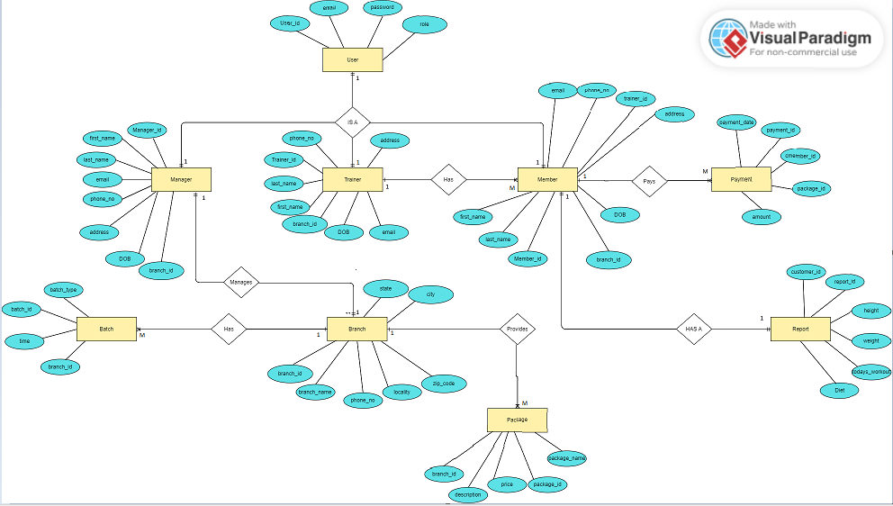
E-R Diagram

Slide 5
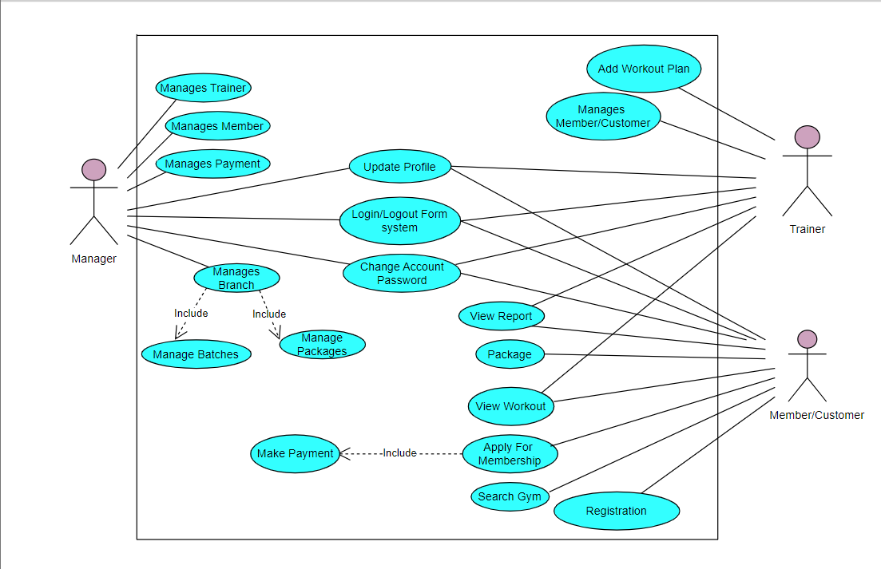
Use Case Diagram

Slide 6
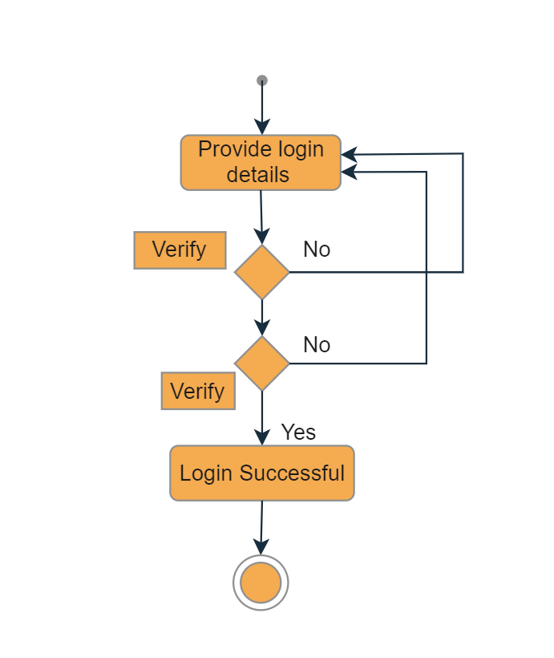
Login Activity Diagram

Slide 7
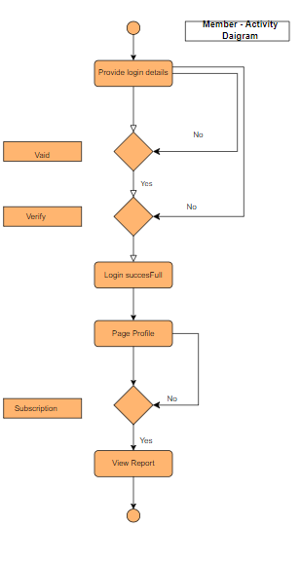
Member Activity Diagram

Slide 8
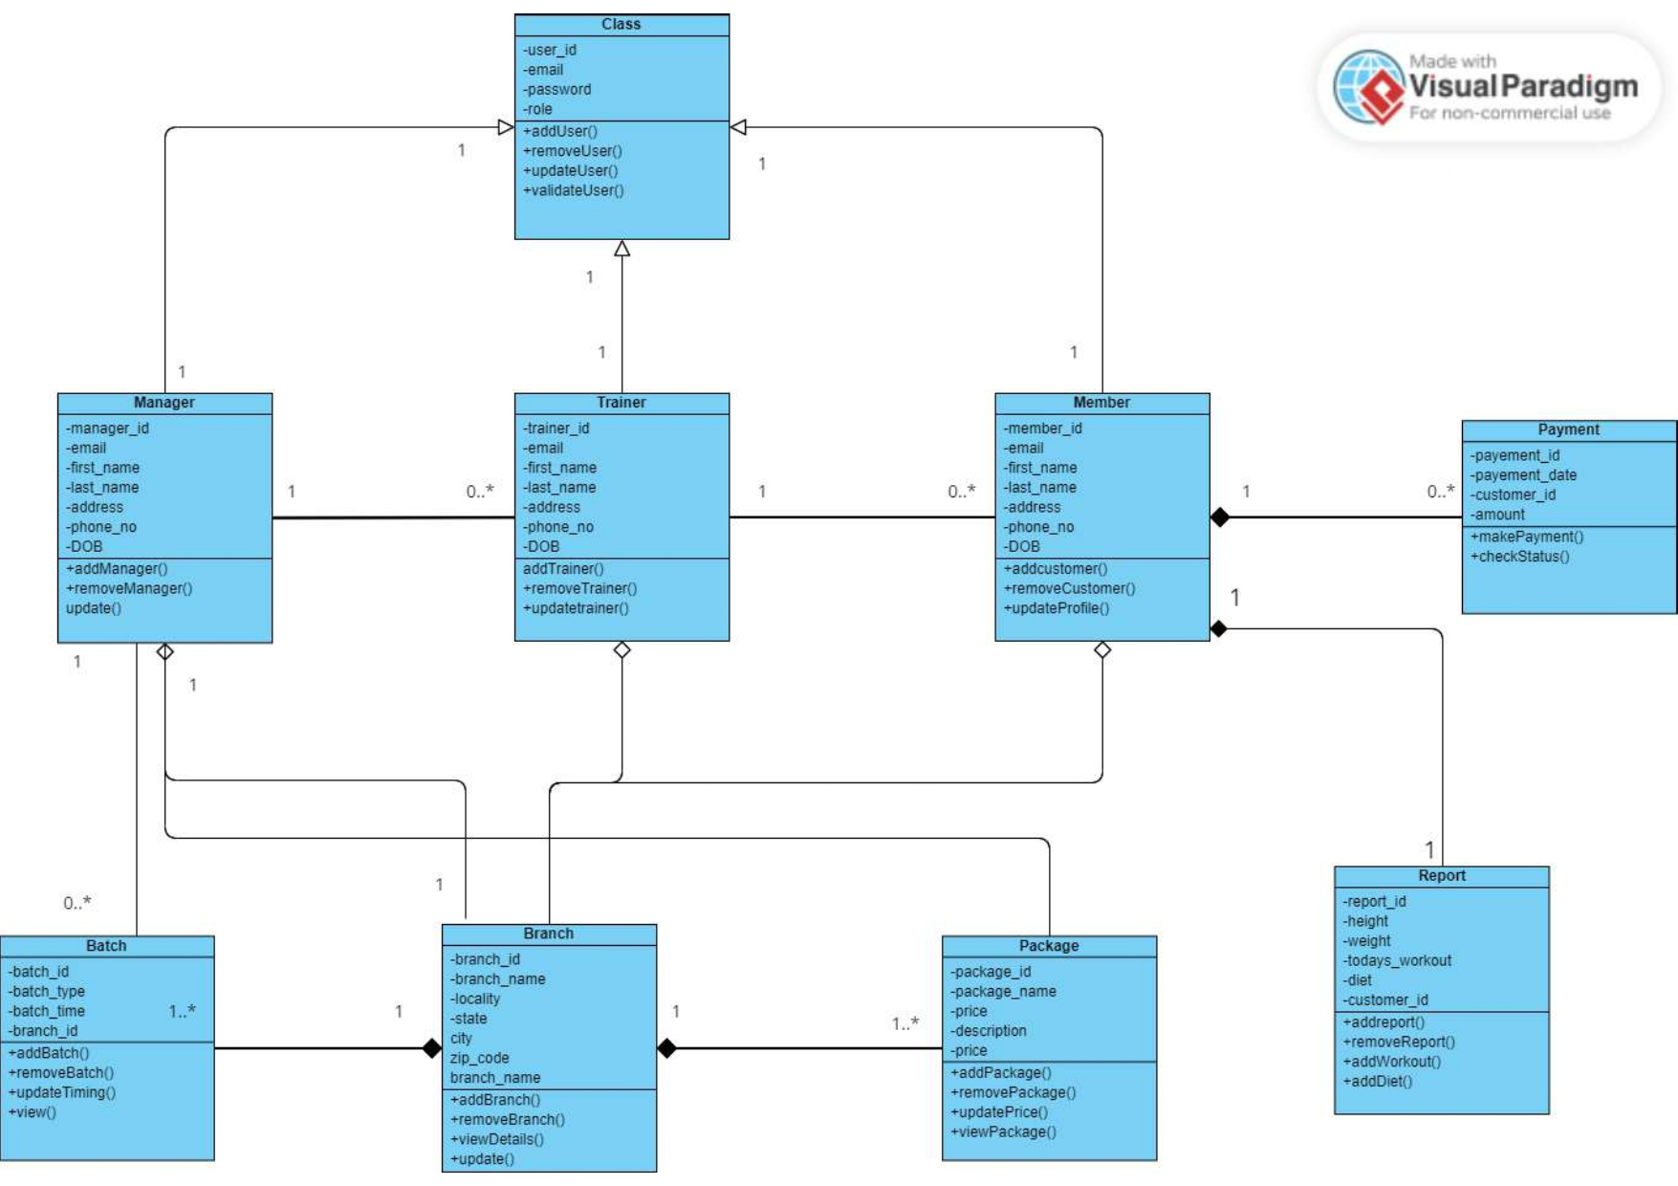
Class Diagram -

Slide 9
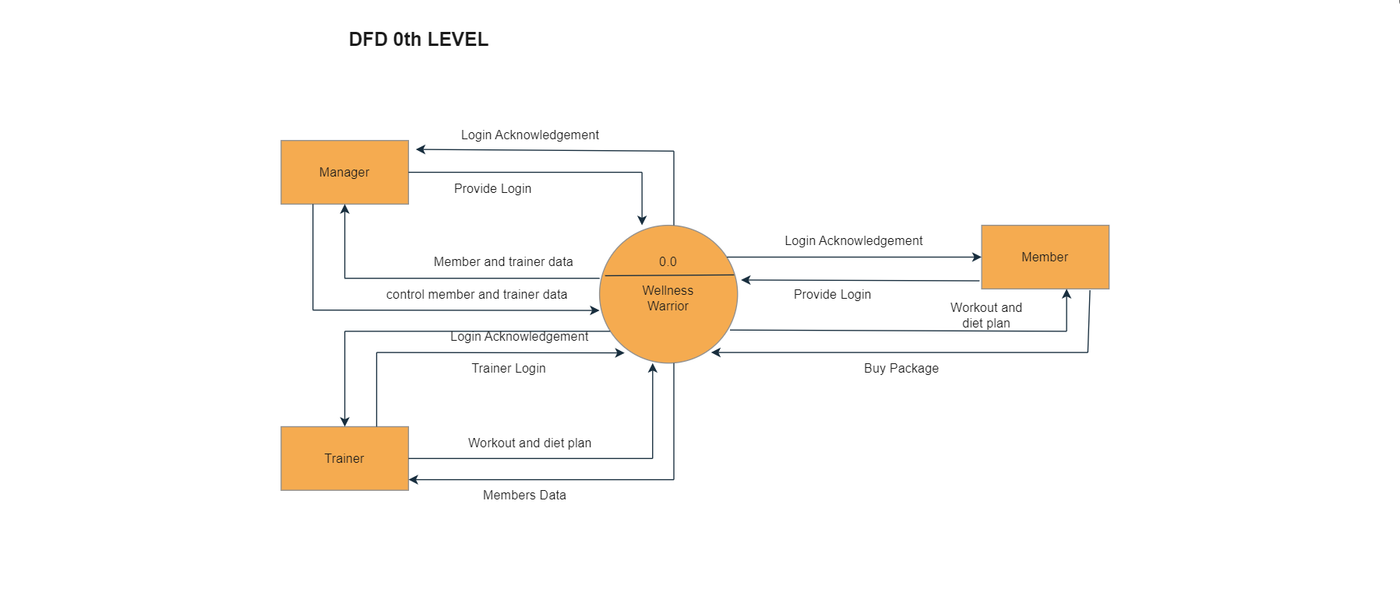
Zero Level DFD

Slide 10
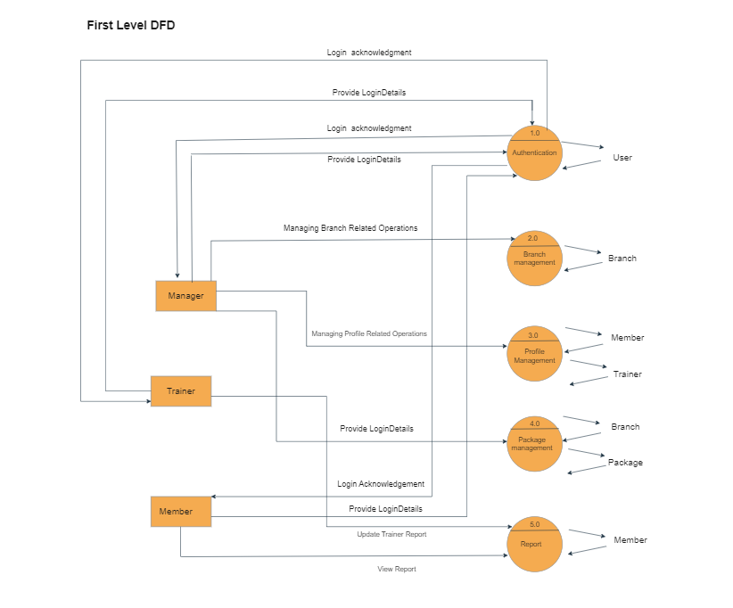
First Level Diagram

Slide 11
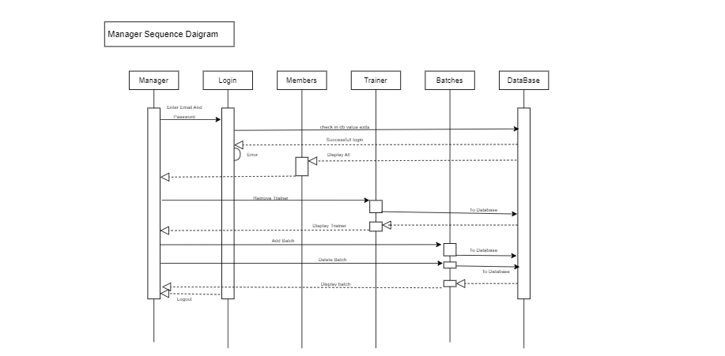
Manager Sequence Flow Diagram

Slide 12
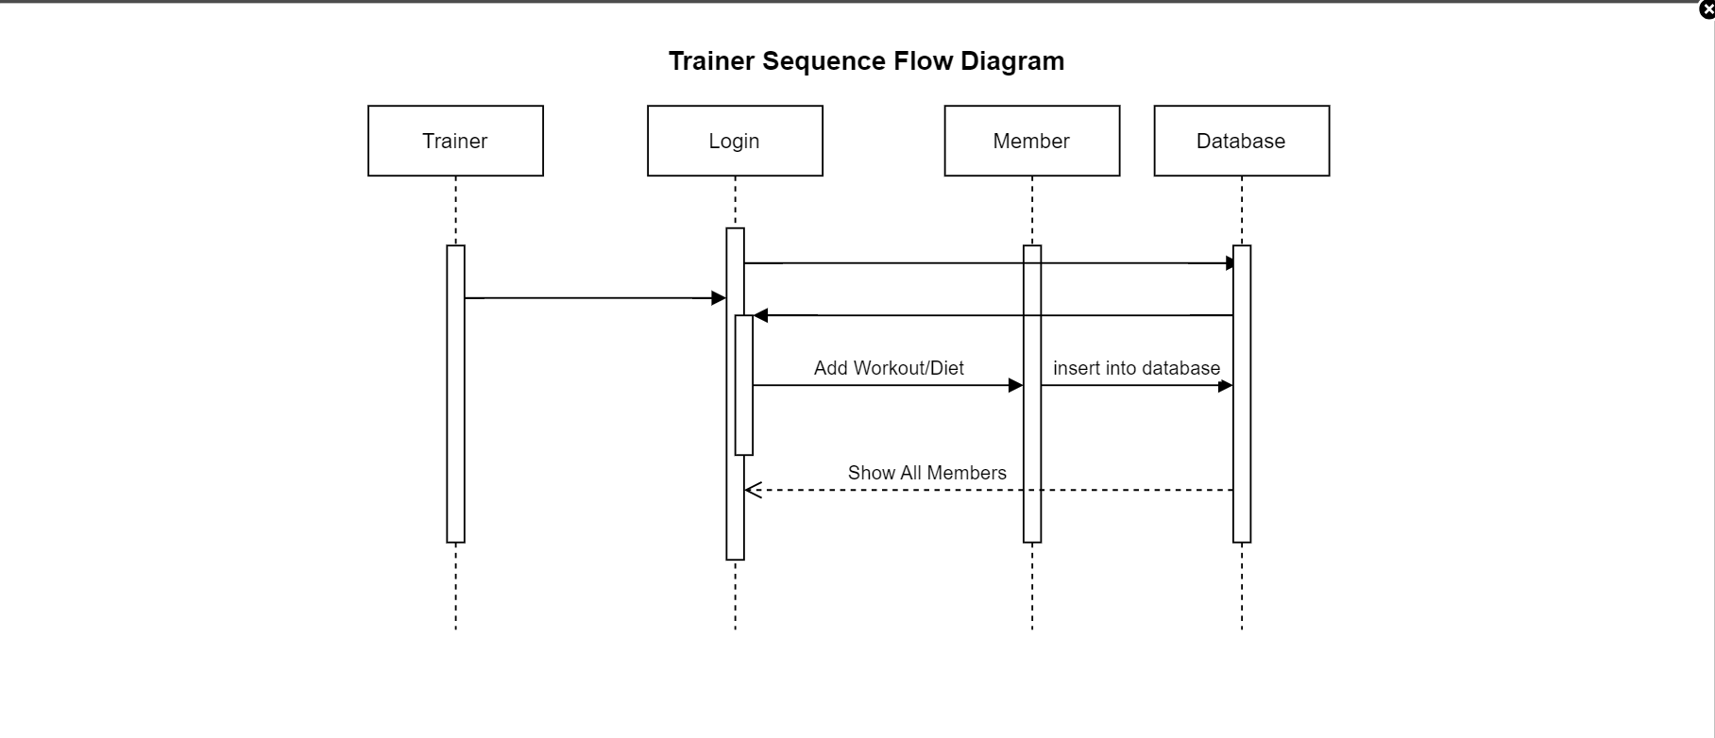
Trainer Sequence Flow Diagram

Slide 13
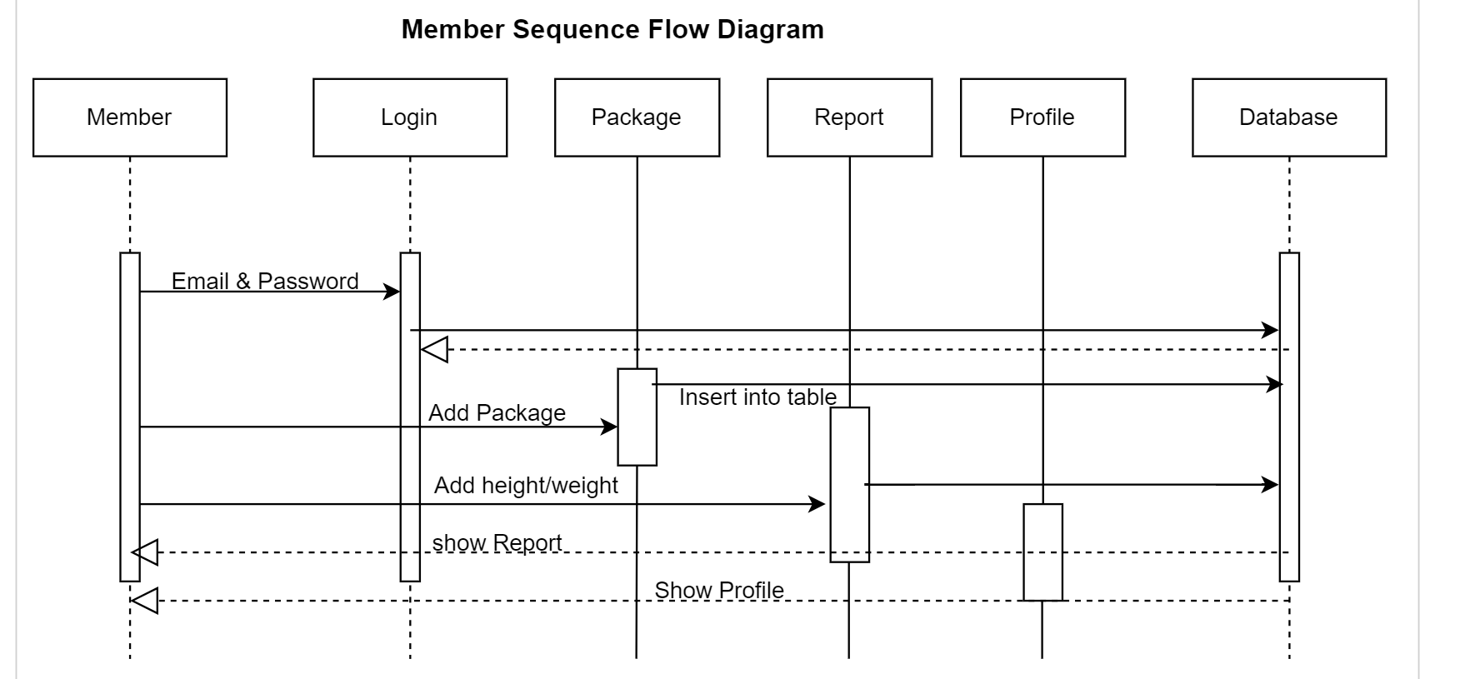
Member Sequence Flow Diagram

Slide 14
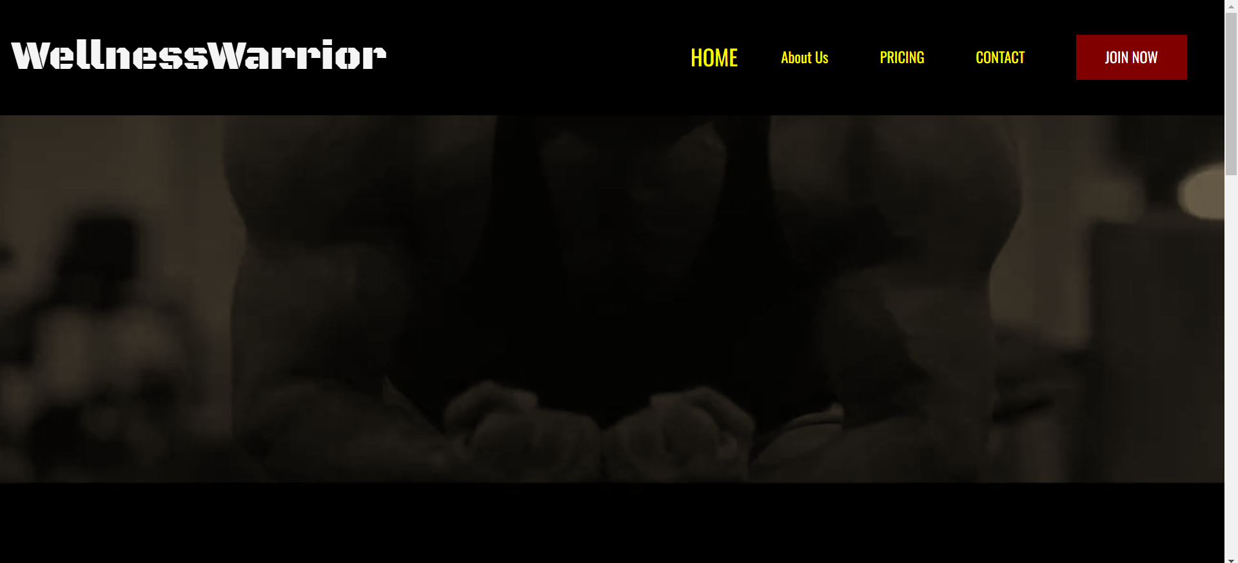
HomePage

Slide 15
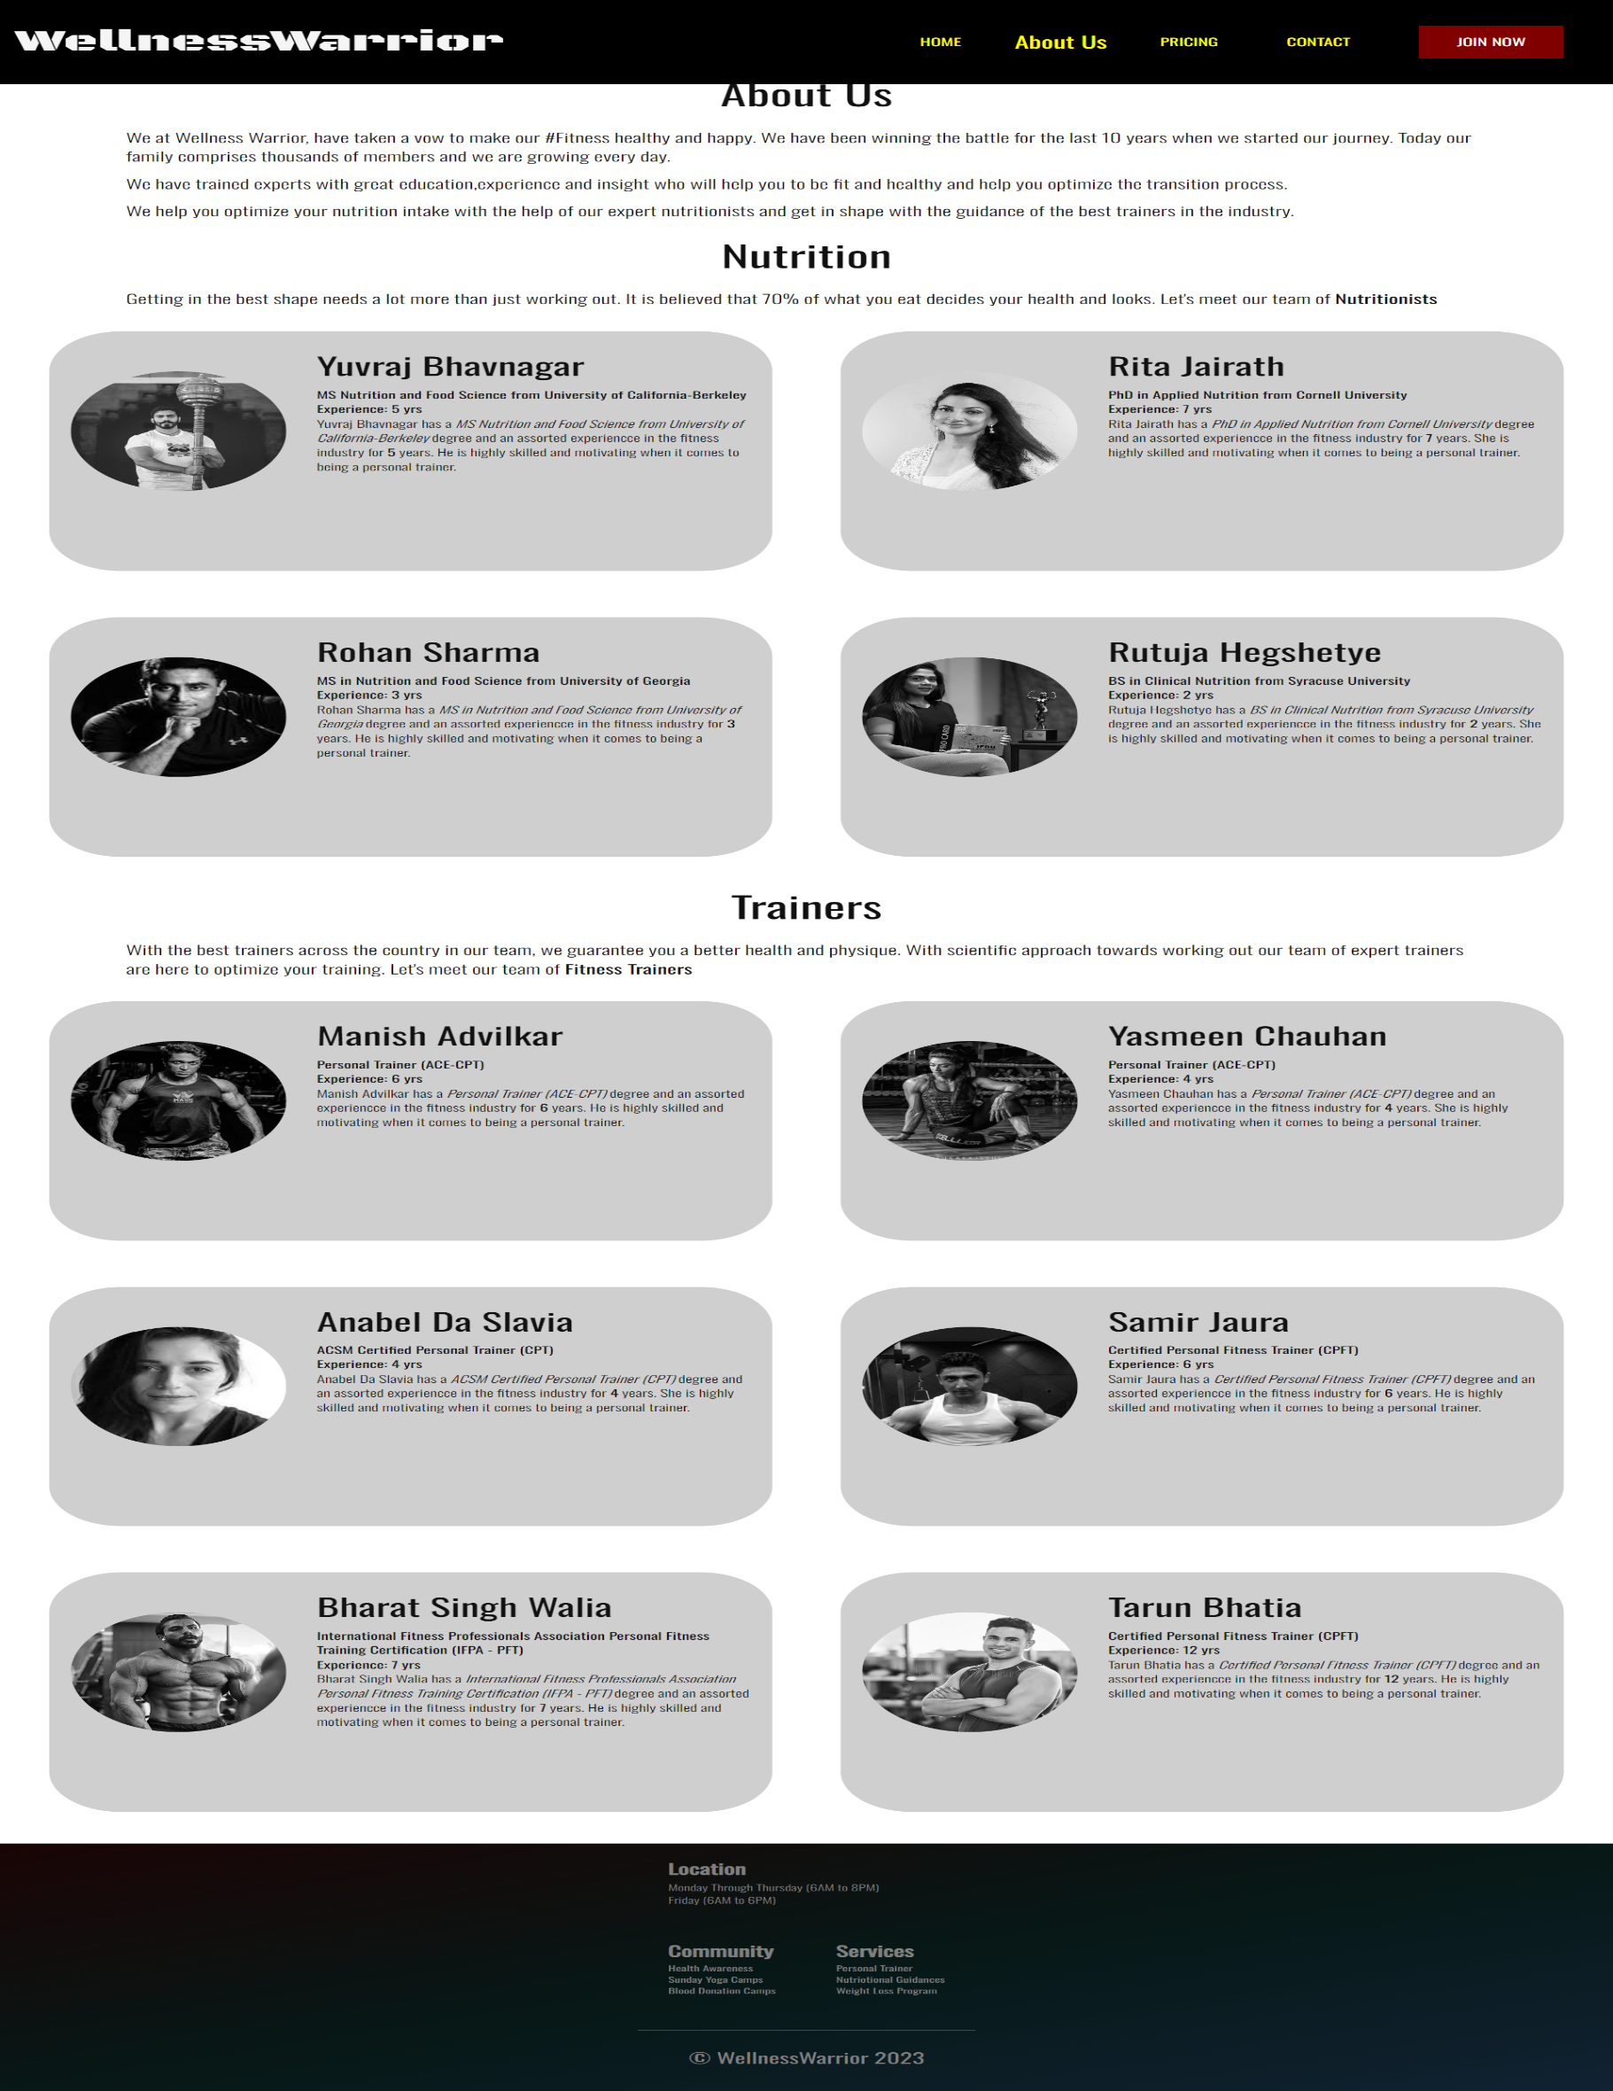
AboutUs Page

Slide 16
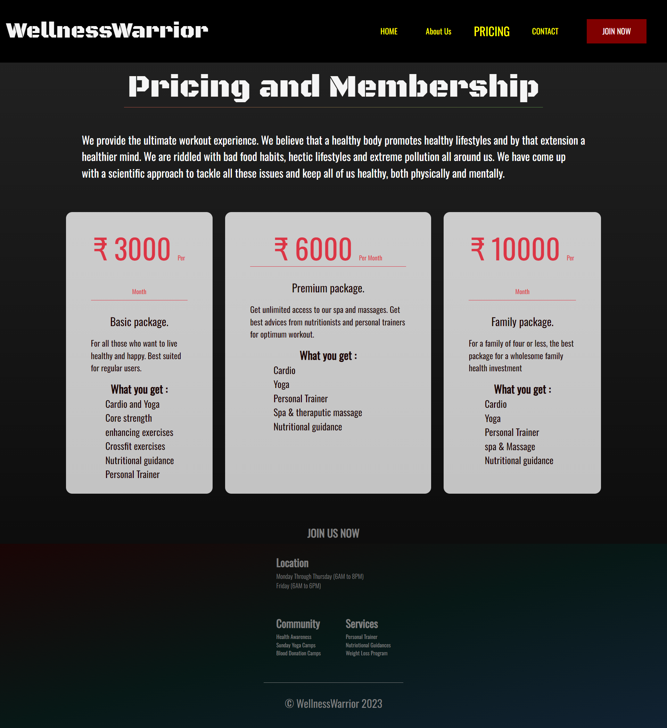
Pricing and Membership Page

Slide 17
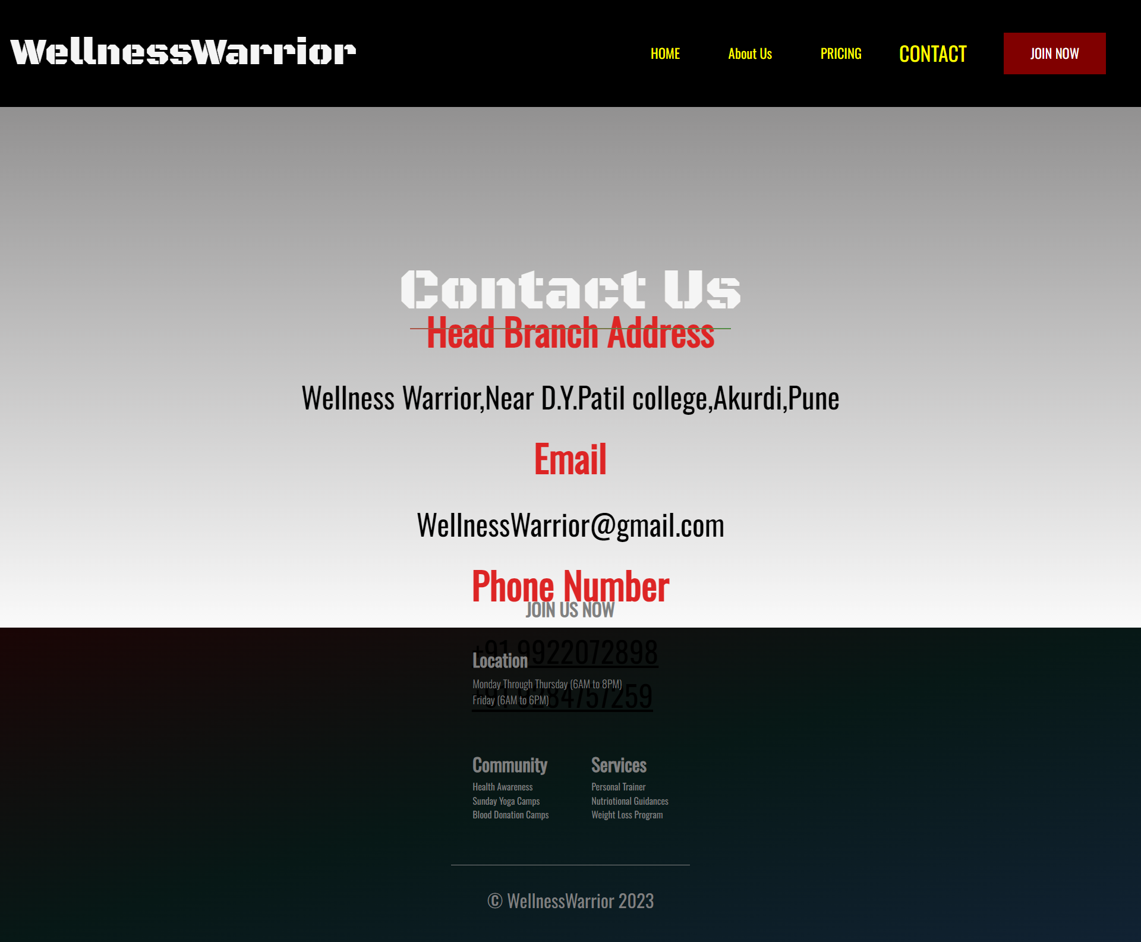
Admin Role:
Contact Us Page

Slide 18
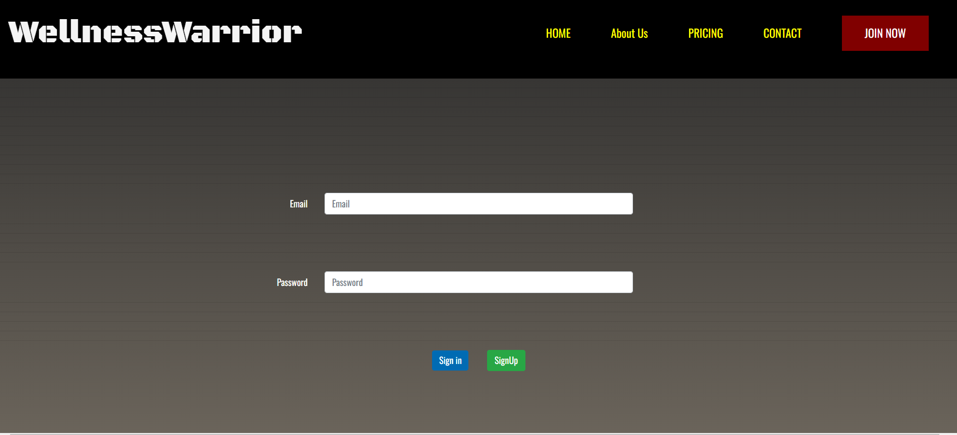
Login Page

Slide 19
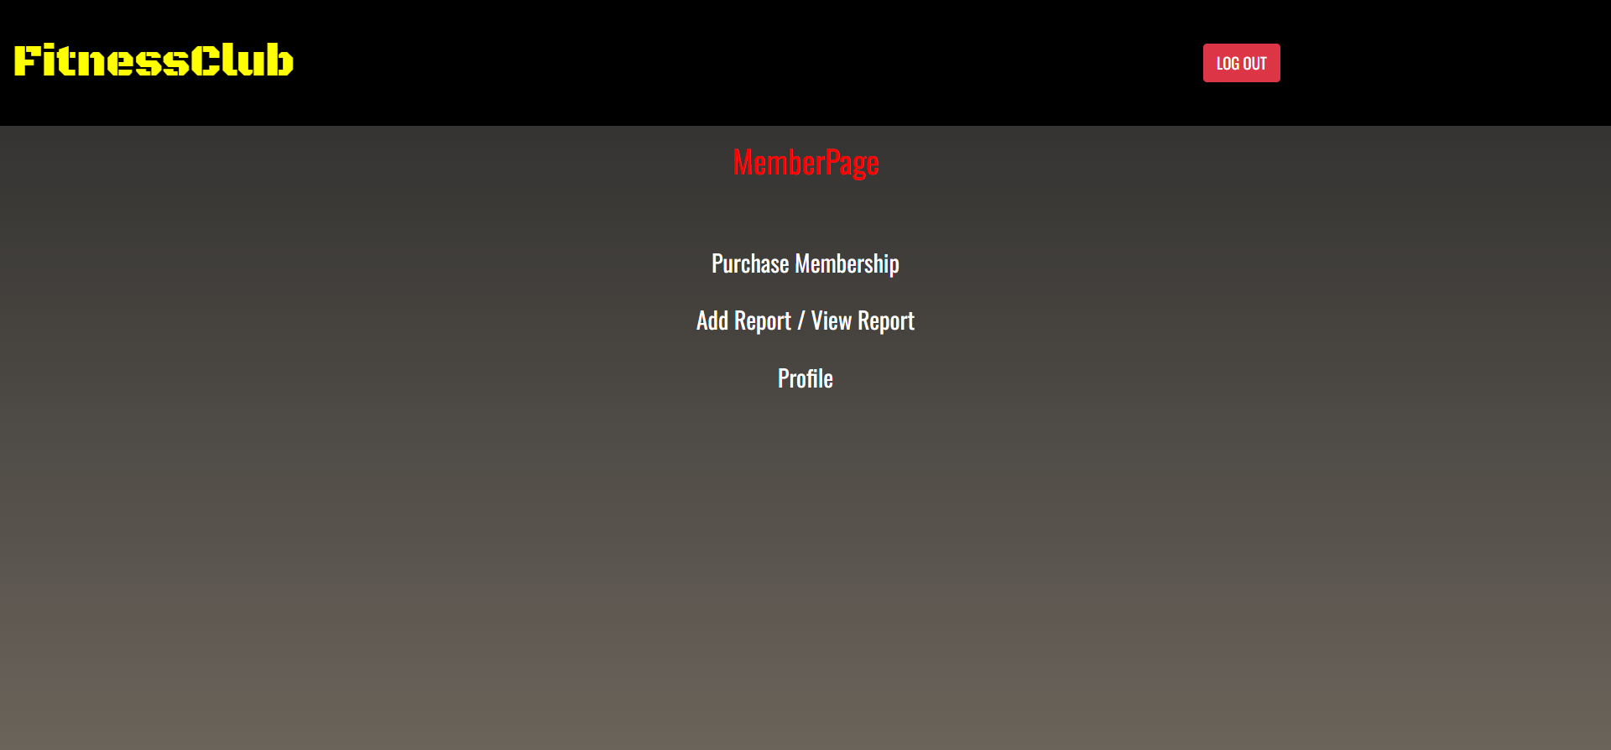
Member Role-
Login
Purchase Page
Report Page
Member Profile
Page
Logout

Slide 20
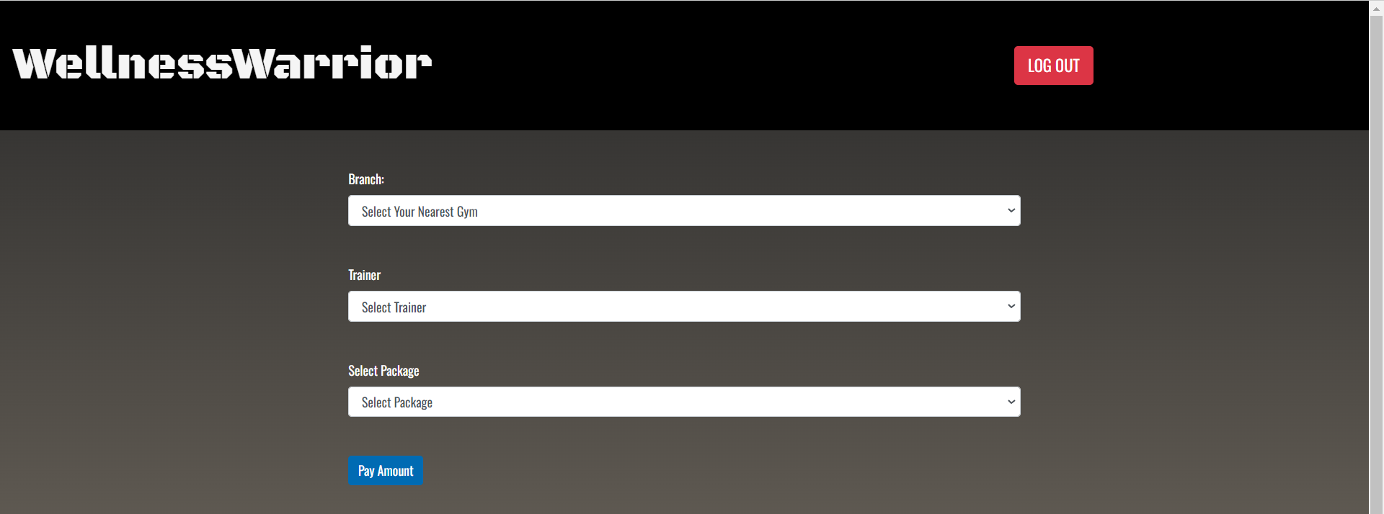
Purchase Page

Slide 21
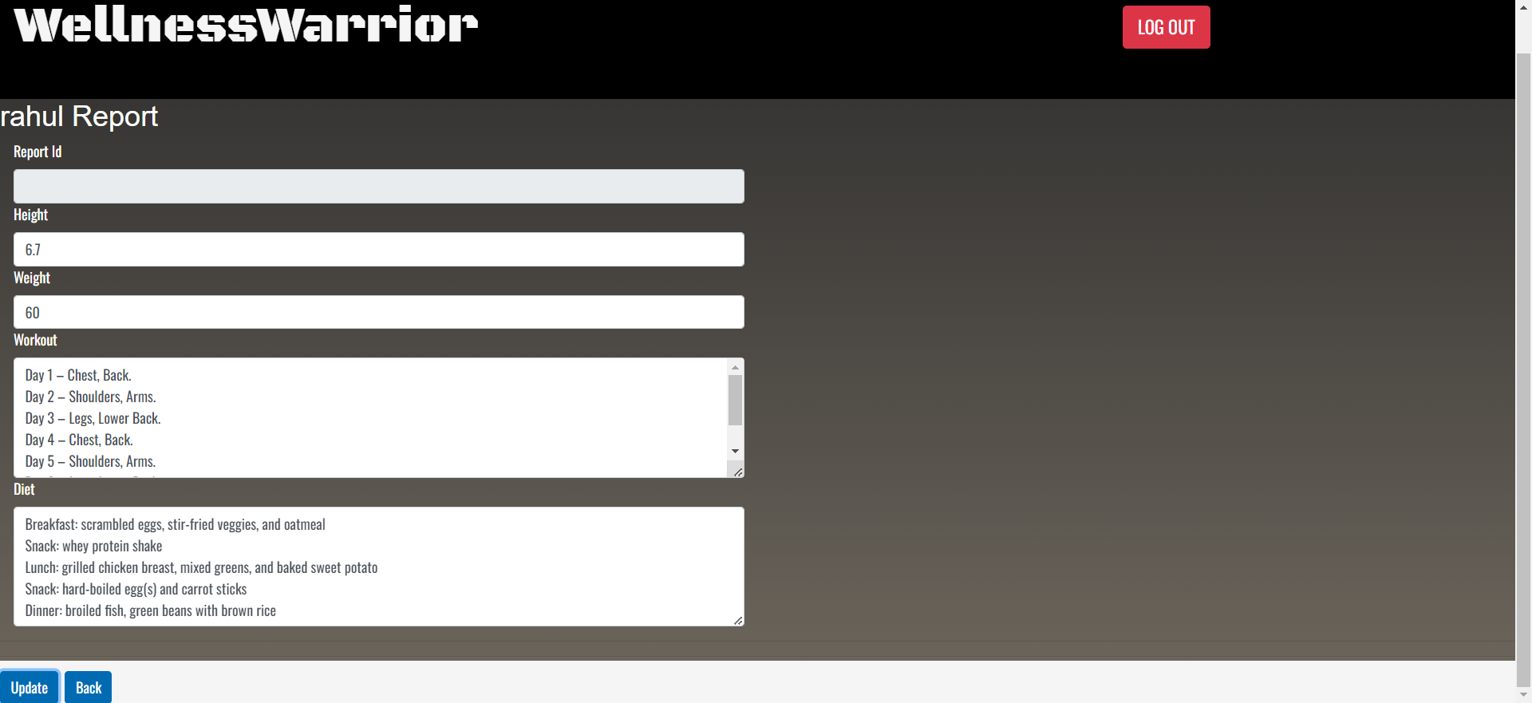
Report Page

Slide 22
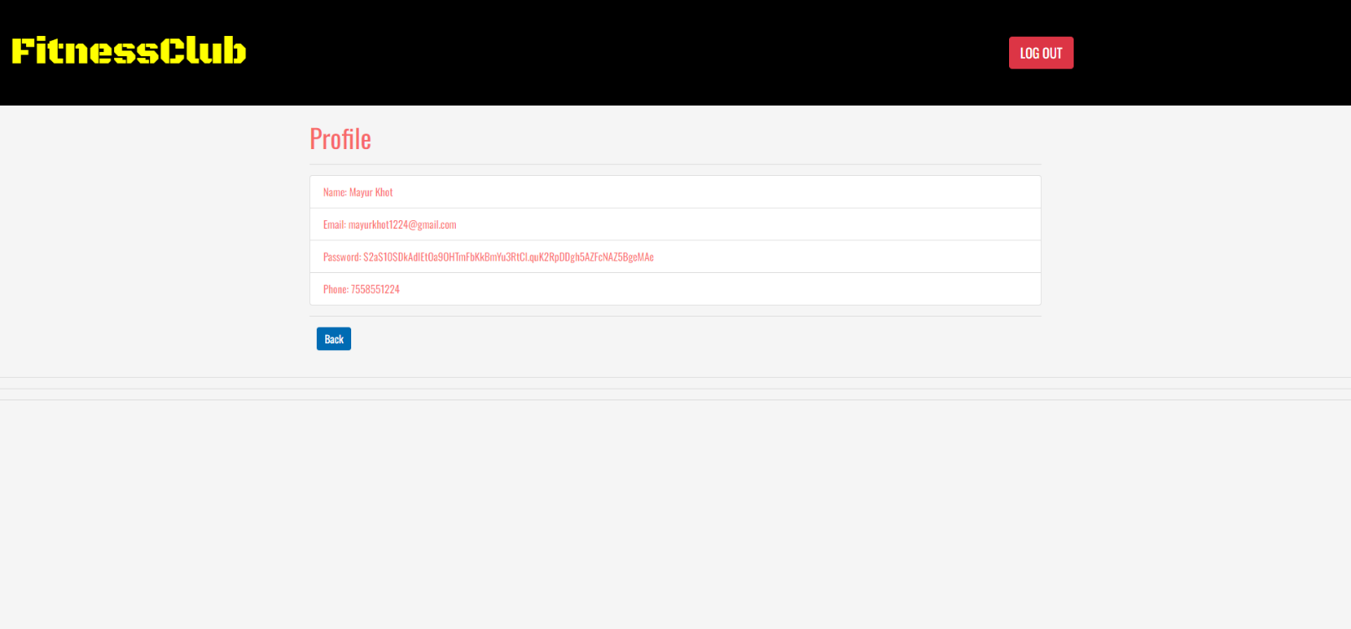
Member Profile Page

Slide 23

Trainer Role-
Login
Trainer Page
Update Report
Page
Trainer Profile
Page
Logout

Slide 24
Update Report Page

Slide 25
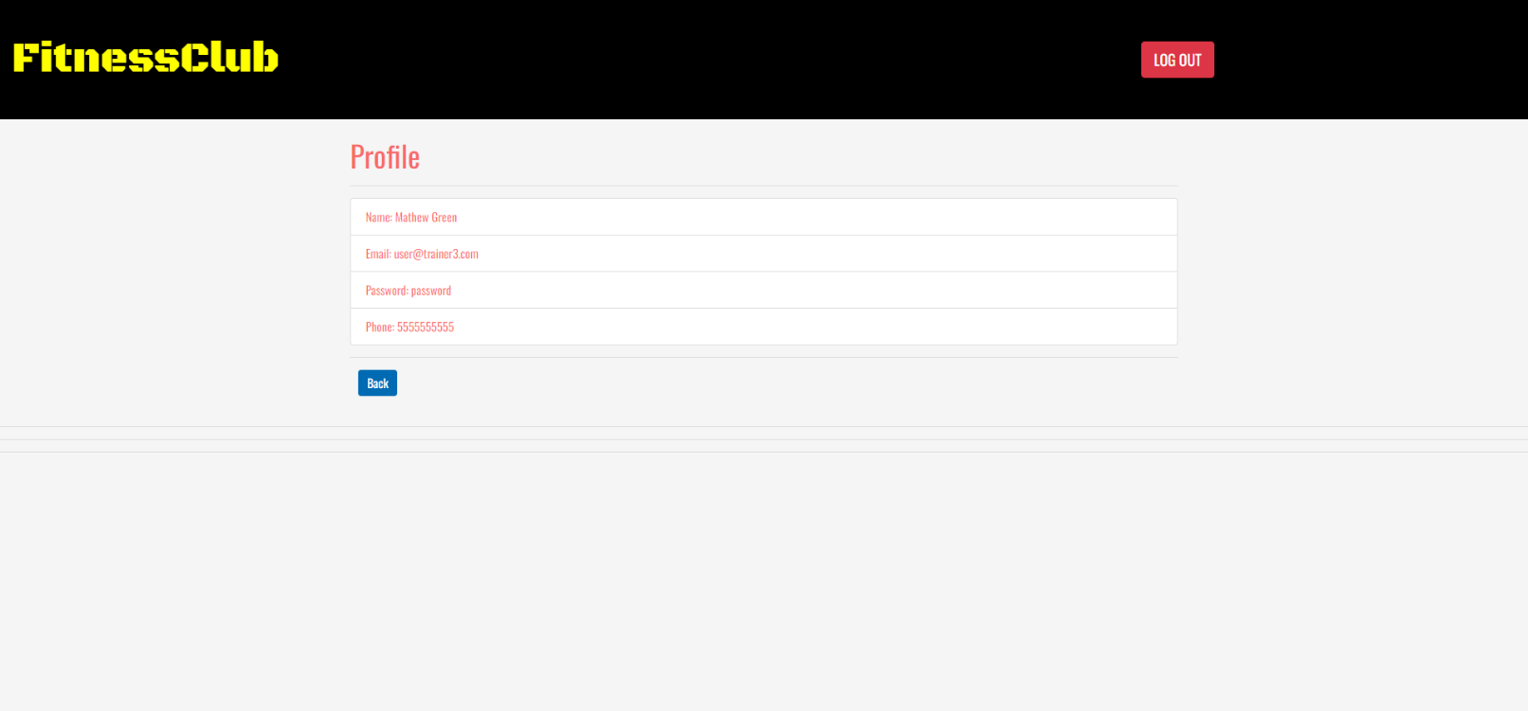
Trainer Profile Page

Slide 26
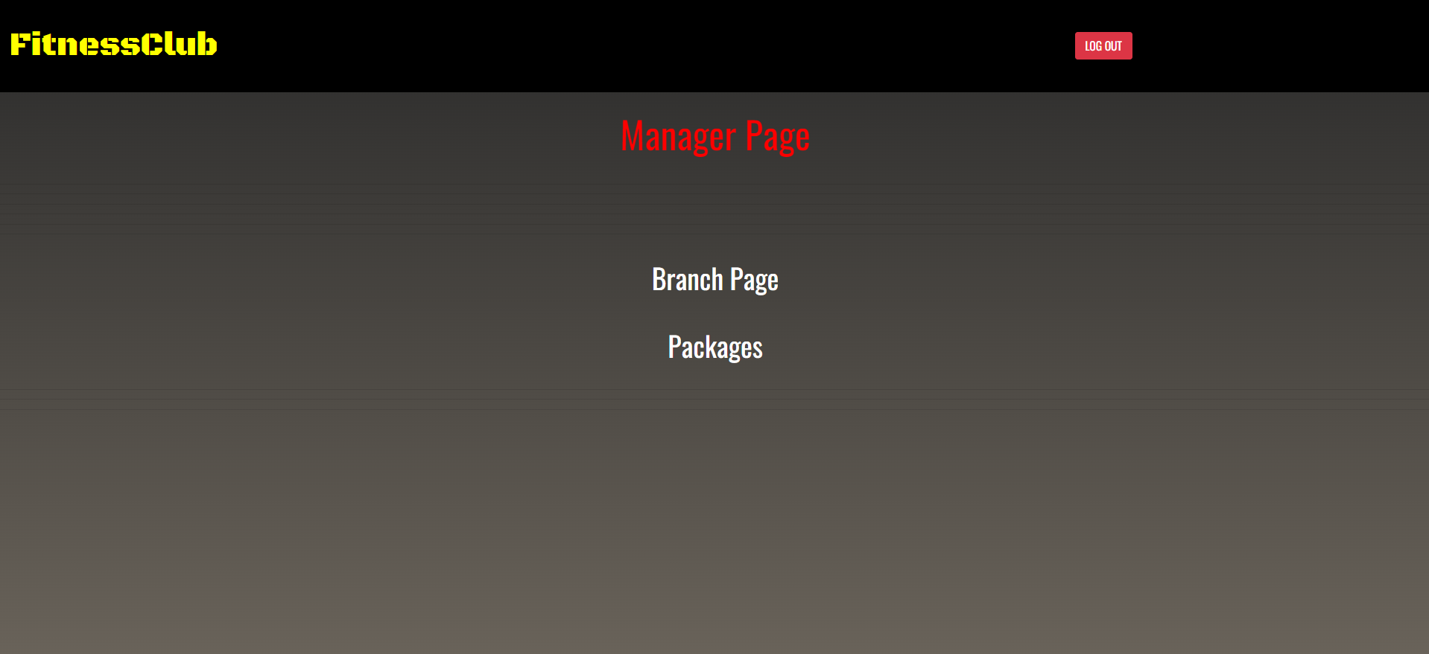
Manager Role-
Login
Branch Page
Branches
Packages
Logout

Slide 27

Manager Page

Slide 28
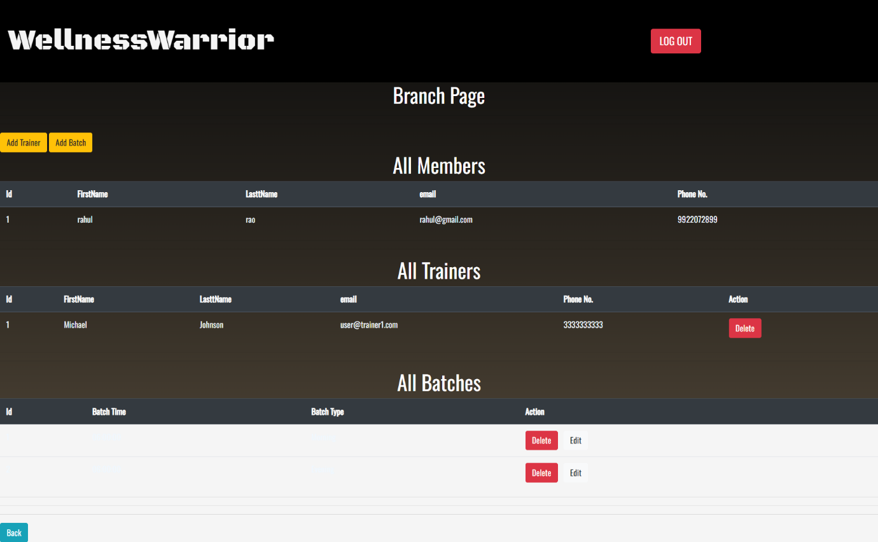
Branch Page

Slide 29
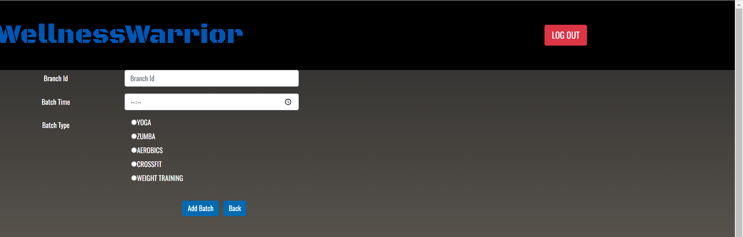
Add
Branch Page

Slide 30
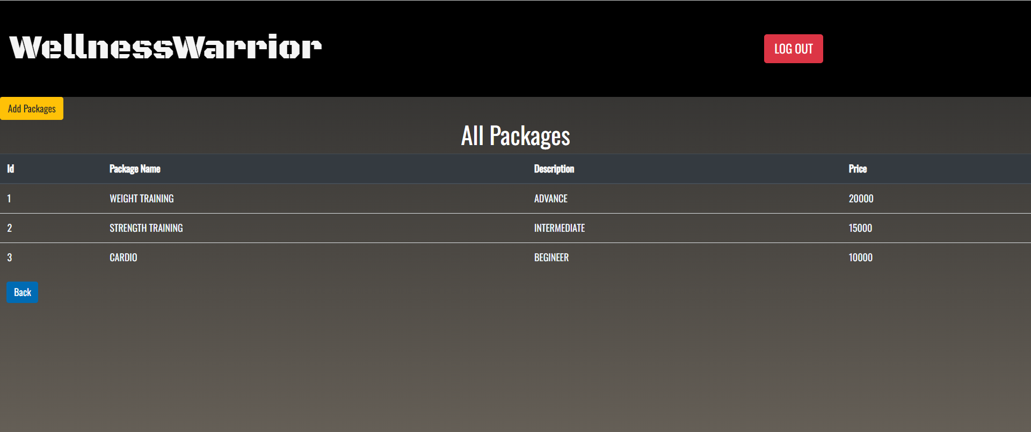
All Package
Page

Slide 31
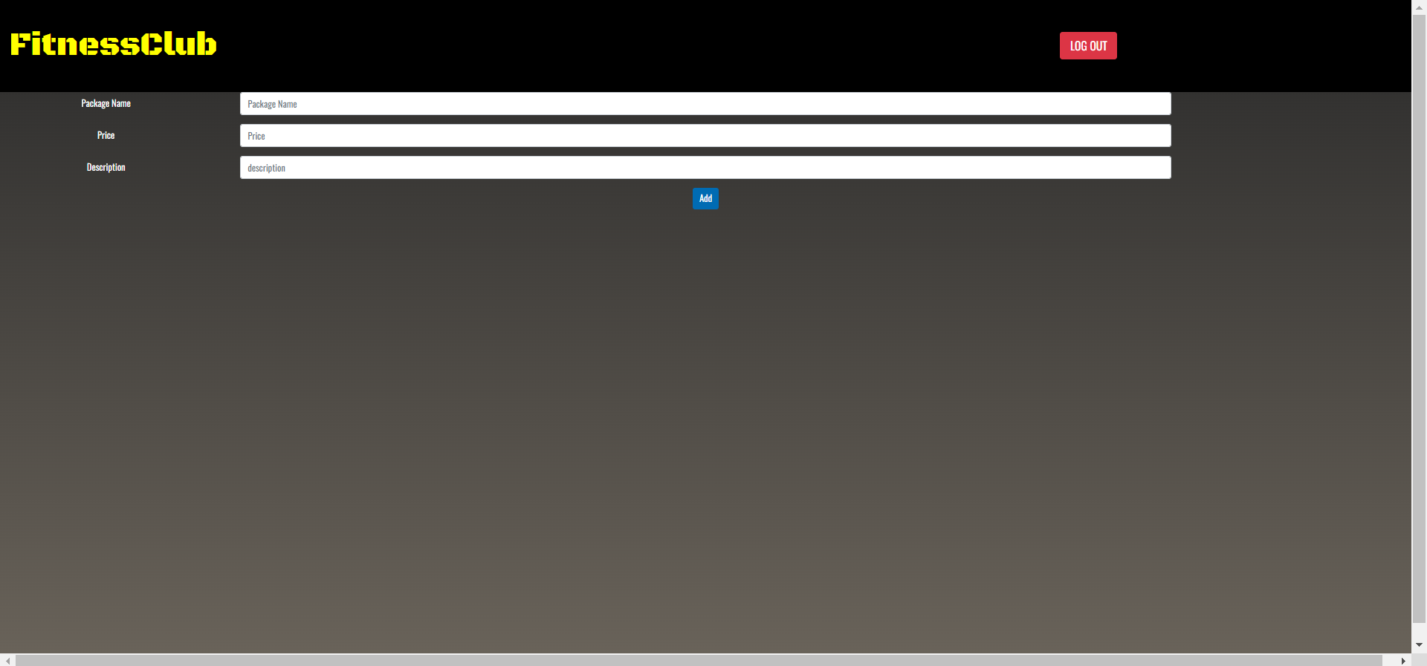
Add Package Page

Slide 32
Conclusion
It is efficient and less time consuming. The purpose of this project was to develop a web application for easy access to gym.
This project helps us in gaining practical knowledge and we a got a hands on experience on several topics like designing a web page using ReactJs, use of responsive templates ,using bootstrap components easily and helps in management of database using MySQL.
It allows owners to manage their gym, customer to view the packages provided by gym and booking their session online as per requirement. The administrator module will able to manage branch activity, gym activity, trainer activity, facility activity.

Slide 33
Future Scope
This project can be enhanced further by adding payment gateway to reduce the maintenance of cash for Membership purchase payments. Online Workout tutorials and online Expert sessions can be hosted on this site for better customer satisfaction. The software is flexible enough to be modified and implemented as per future requirements. We have tried our best to present this free and user–friendly website to Institutes.

Slide 34
THANK YOU

